Slide 1
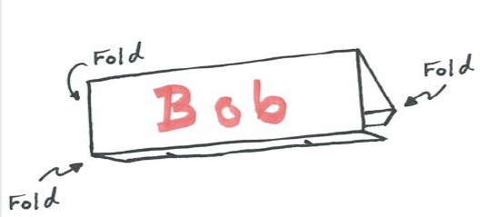
As you arrive, please make a name tent.
Figure 1. Name tent instructions. From https://kb.mit.edu/confluence/pages/viewpage.action?pageId=152584661
The name you would like to be called
Your pronouns, if you choose
Decorations, if you choose

Slide 2
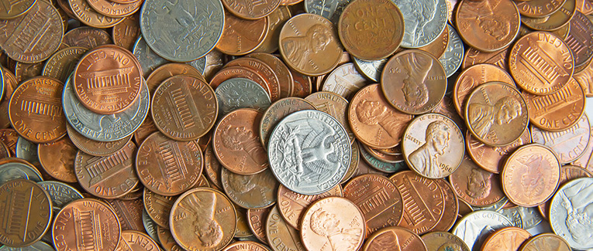
Figure 2. Assorted Coins. From https://www.immihelp.com/usa-currency-coins/
Slide your penny from the edge of the table into the tape box… You have three attempts to do so

Slide 3
Collaborative Experiential Learning:
Understanding and Application
Presenters: Jordan Blank and Michelle Blank, Goshen College

Slide 4
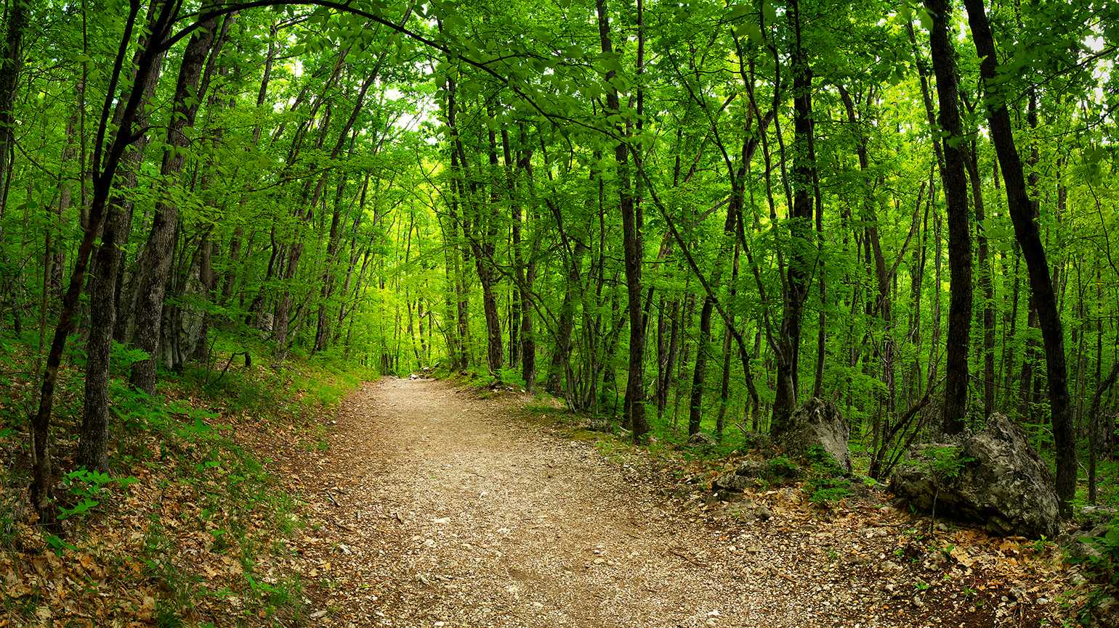
The Plan for Our Journey
Figure 2. Wooded path. Retrieved from https://www.guideposts.org/better-living/health-and-wellness/living-longer-living-better/5-spiritual-lessons-from-lifes-trail
Agenda
Experiential Learning Cycle
Large Scale Projects
Smaller Scale Projects
In Your Context
Notes:
Brains don’t like surprises!

Slide 5
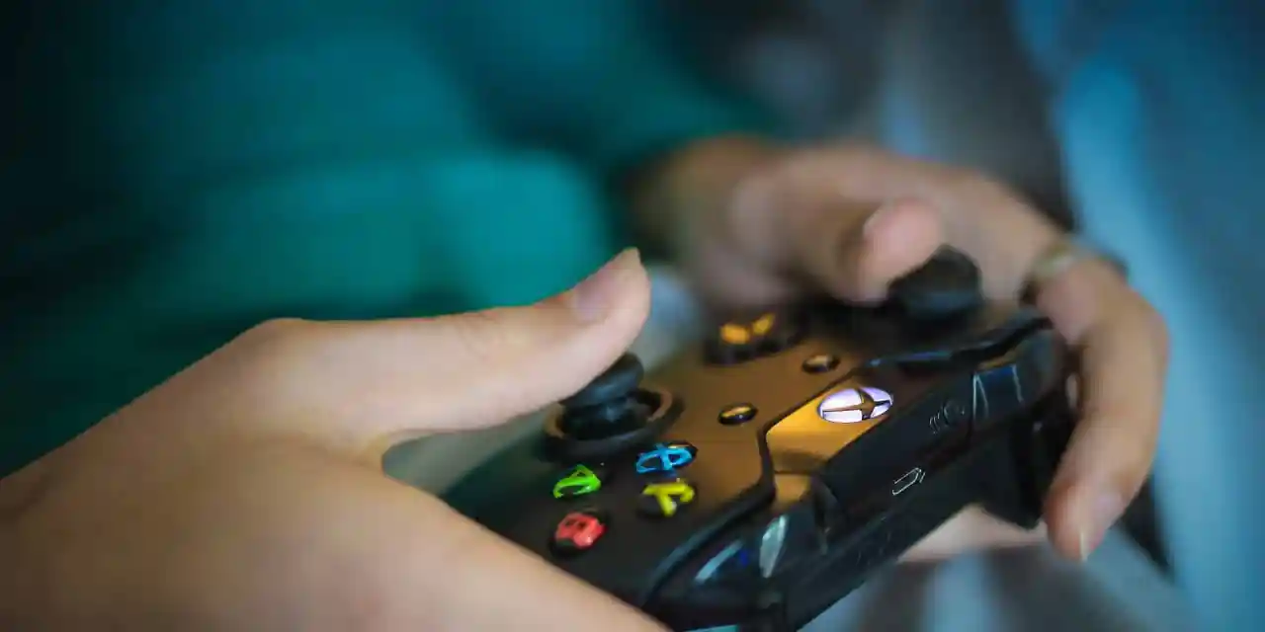
The Doer IS the Learner!!!
Figure 3. Video game controller. From https://globalsummersacademy.com/2021/07/11-benefits-of-experiential-learning/

Slide 6
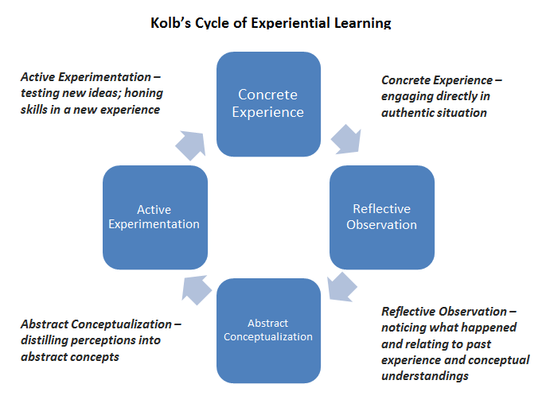
Figure 4. Kolb’s Cycle of Experiential Learning. From https://www.bu.edu/ctl/guides/experiential-learning/
Notes:
Who Kolb was, what he posited, brief summary of cycle (not reading)

Slide 7

WHY Experiential Learning?
Notes:
Short discussion

Slide 8
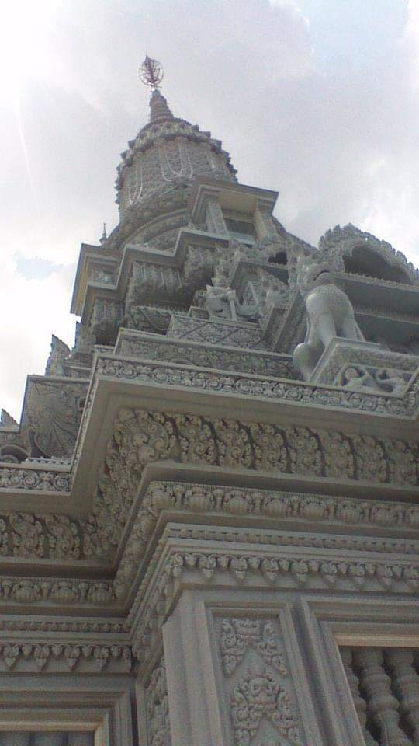

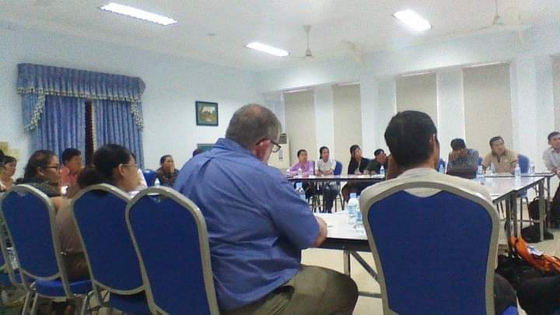

Figure 5. Buddhist Temple.
Engaging directly in an authentic situation
Testing new ideas, honing skills in a new experience
Figure 6. Buddha Relic Doors.
Figure 8: Cambodian NGO Conference.
Noticing what happened and relating to past experience
Distilling perceptions into abstract concepts
Figure 7. Thought Bubble.
Notes:
Big example in Cambodia. Teaching cross-cultural communication. Interaction with nuns -> religious tenants -> hadn’t considered -> would affect audience reception -> added in moving forward. Step 2 is just observation (I noticed pilgrims, the underpinnings of Bhuddist teachings in population). Where is the collaboration

Slide 9
Let’s practice some application…
How does the coin activity from the beginning of the session exemplify the 4 steps in the Experiential Learning Cycle? (TWPS)
Notes:
Coins

Slide 10
Living-Learning Community: Sustainability Garden Home
Daily Monitoring:
What is happening?
Moving Forward: What needs tested? What should we do?
Distilling Ideas: What does what happened mean?
Figure 9: LLC Kolb’s Application
Notes:
LLC- where is the collaboration

Slide 11
What are the benefits of collaborative learning?
Notes:
Short discussion

Slide 12


Slide 13

Introduction to Bicycle Riding - ES 101
Read The History of Bicycles
Read The World’s Fastest Man
Read How Cycling Can Save the World
Watch the Tour de France highlight video
Go Ride a Bike (You will be graded…)

Slide 14
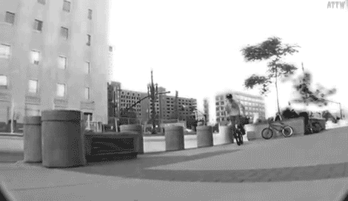

Slide 15
Concrete Experience
Build model and write out instructions
Active Experimentation
Reflective Observation
Reiterated instructions
Where did the other team struggle in your instructions?
Abstract Conceptualization
What needs to be iterated in your instructions to make them effective?

Slide 16

Brainstorming
Figure 10: Brainstorming. From: https://twuwritesite.wordpress.com/2018/09/11/brainstorming-considering-audience-purpose-format/

Slide 17

Where We Have Been…
Figure 11. Rearview mirror. From https://blogs.covchurch.org/delp/?p=6872
Experiential Learning Cycle
Large Scale Projects
Smaller Scale Projects
In Your Context
Notes:
Brains don’t like surprises!

Slide 18
Presenter Contact Information
Jordan Blank, Goshen College, jblank@goshen.edu
Michelle Blank, Goshen College, mblank@goshen.edu

